Slide 1



How Predictive Analytics Can Power Early Action in Conflict Zones
VIEWS x Data Strategy | Webinar | 8 October 2025
Angelica Lindqvist-McGowan & Paola Vesco

Slide 2


Who Are We?
Angelica Lindqvist-McGowan
Head of Strategic Communications, VIEWS
Department of Peace and Conflict Research, Uppsala University
Paola Vesco
Senior Researcher
Peace Research Institute Oslo
Notes:
We are part of an interdisciplinary research team with staff spread across both of our respective institutions, who work together on a range of projects that aim to understand and predict armed conflict and its humanitarian consequences. One of the key outcomes of this collaboration is very the tool that we are here to talk about today: the Violence & Impacts Early-Warning System – VIEWS.

Slide 3
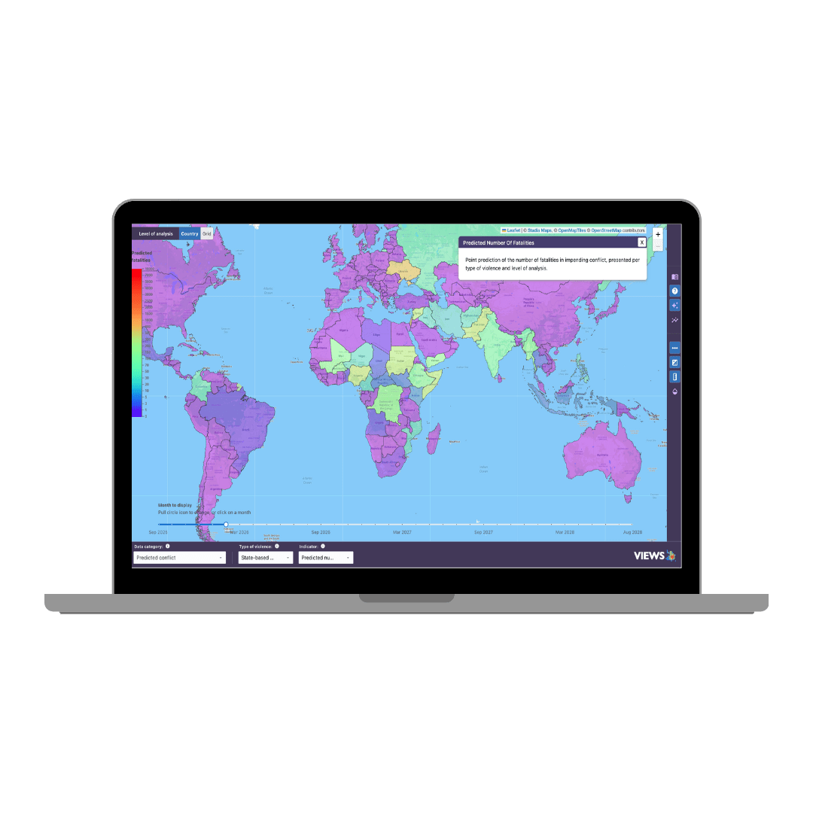
What Is VIEWS?
The Violence & Impacts Early-Warning System (VIEWS) is a cutting-edge AI-powered forecasting platform that provides monthly, forward-looking predictions of armed conflict.
Global coverage at the country level
High-resolution (0.5°), subnational forecasts across Africa and the Middle East
Rolling 3-year window, updated monthly
Open data and scalable tools to support policymakers, practitioners, and fellow researchers in anticipating violence, allocating resources, and mitigating human suffering.

Slide 4
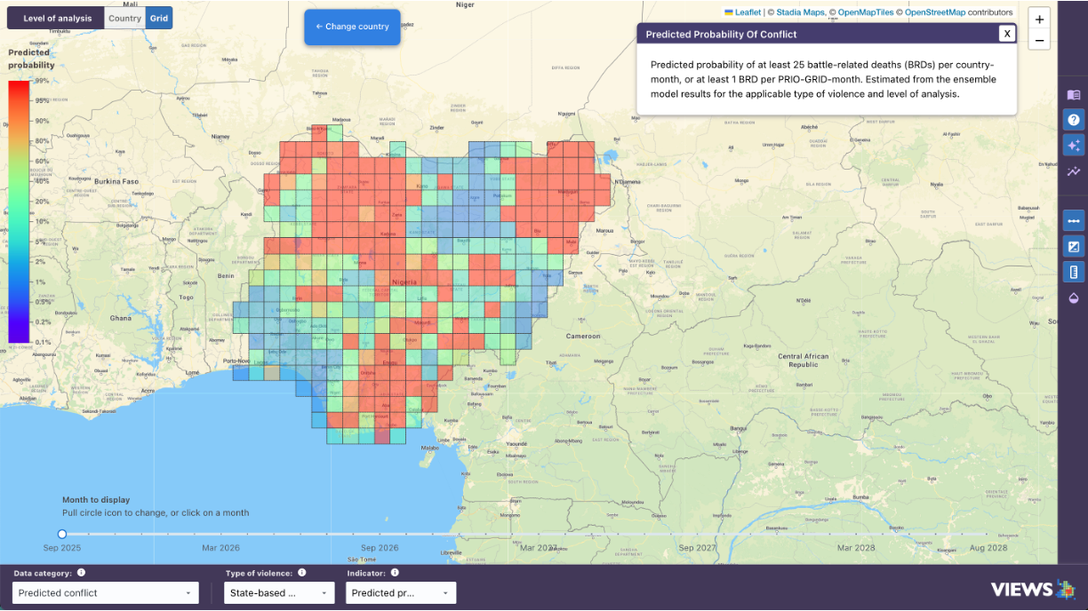
What VIEWS Predicts
Forecasts for the predicted likelihood and intensity of armed conflict
Forecasted number of fatalities per country/grid cell and month
Forecasted probability of observing at least 25 BRDs per country and month, and/or at least 1 BRD per grid cell and month
Current focus on state-based conflict (UCDP definition)
Fatal use of organized armed force, resulting in at least 25 direct deaths per country and year
Due to an incompatibility over government of territory
Involving at least one governmental actor, affiliated with the ‘party controlling the capital of the state’
Notes:
Maybe cite ucdp here?

Slide 5
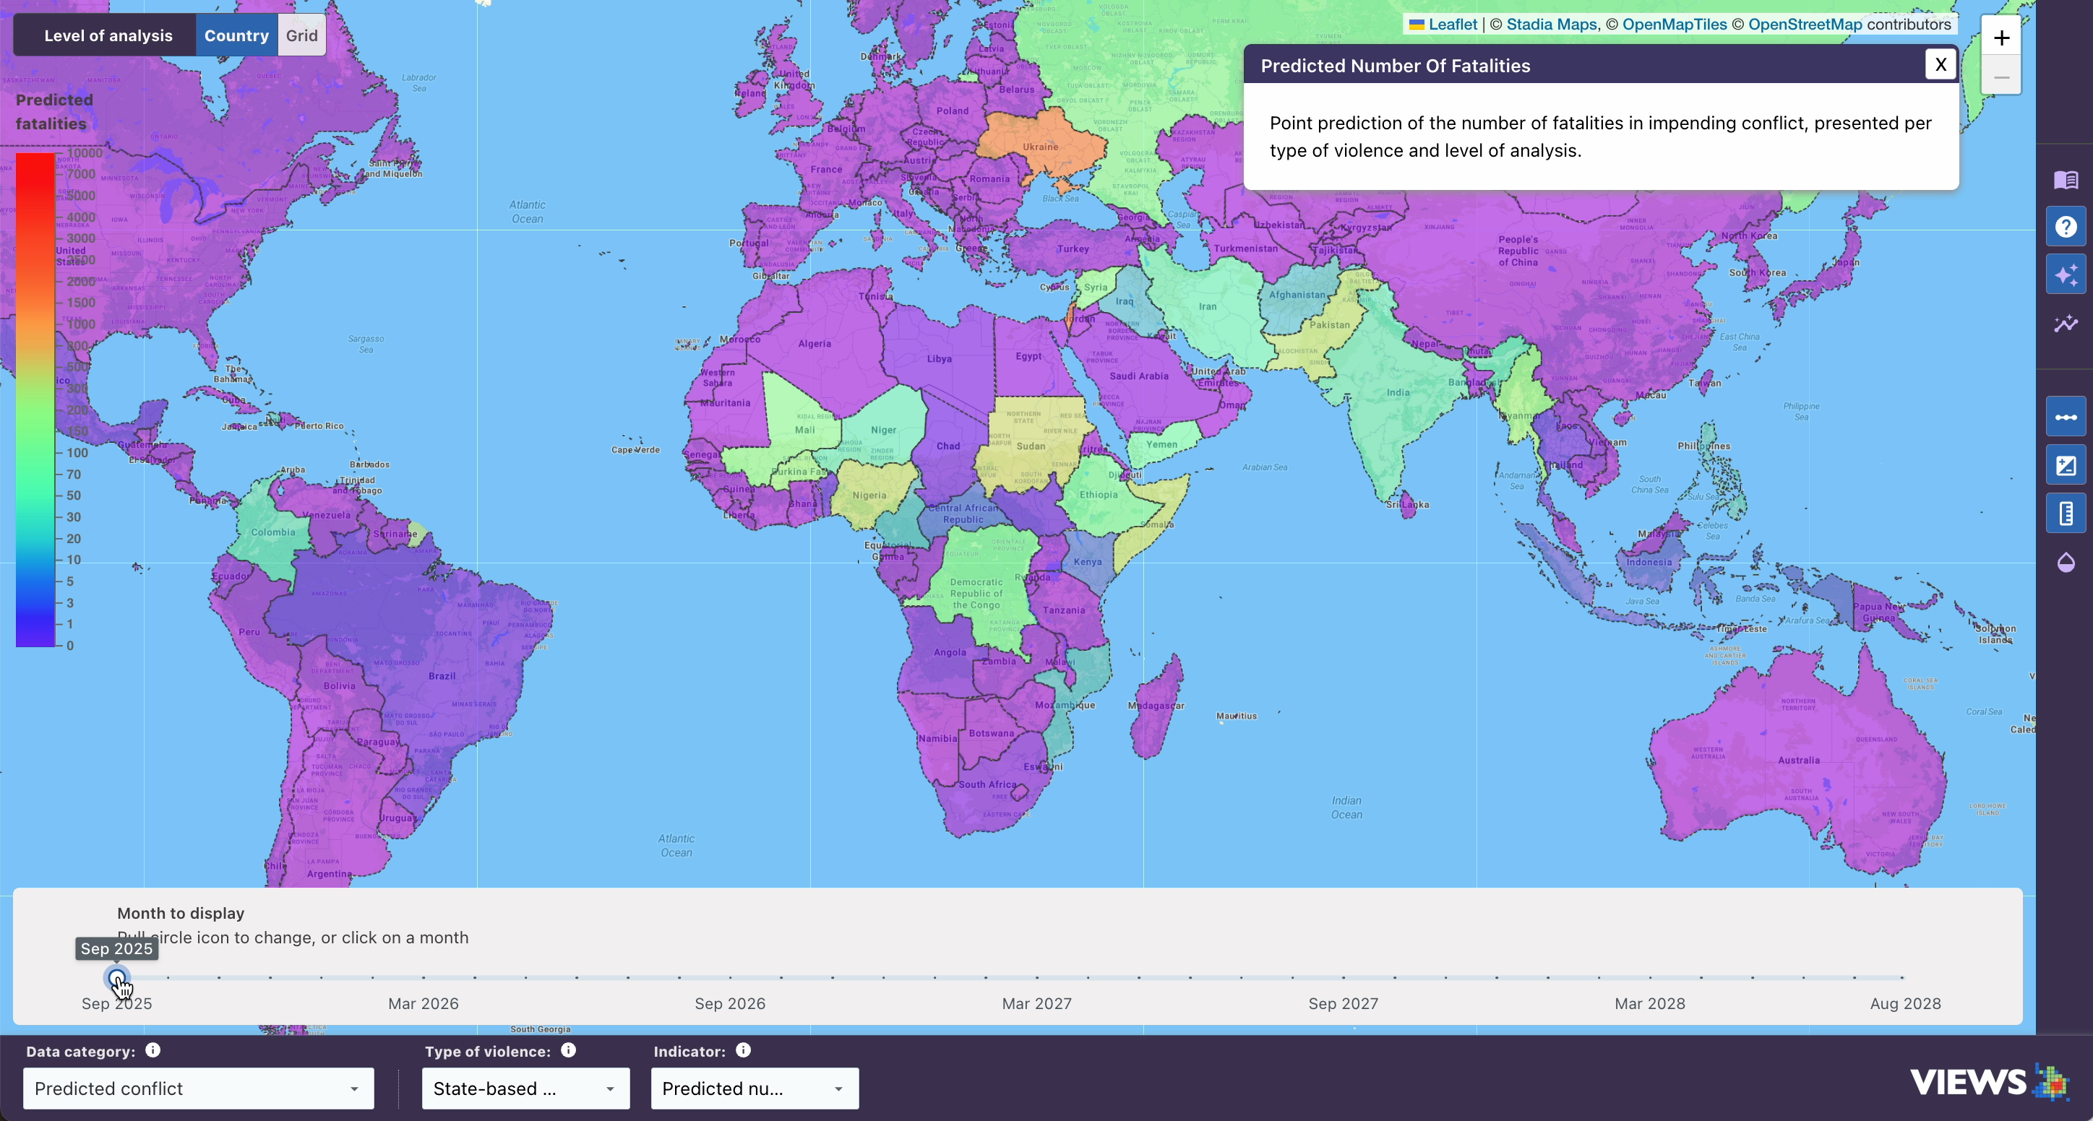


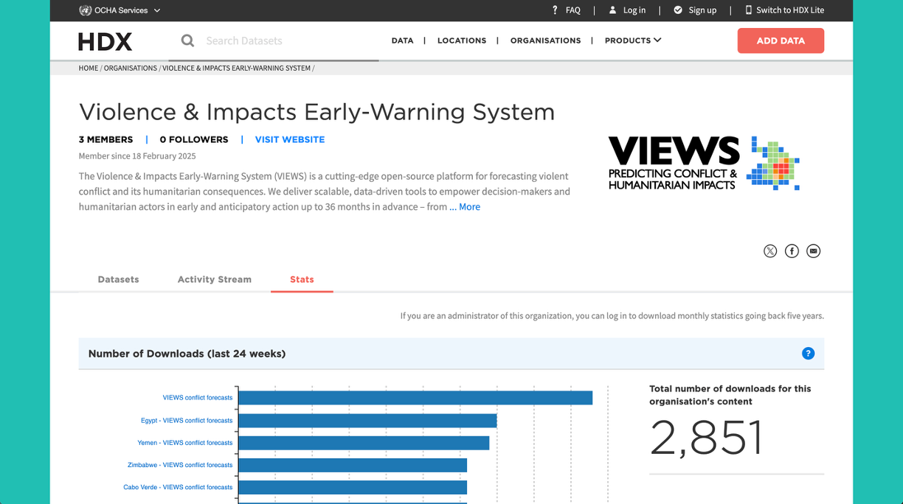
Access Points
Photo: Adobe Stock
Photo: Adobe Stock
Data Dashboard
API
Downloads
HDX
Explore the VIEWS forecasts in our interactive data dashboard.
Connect our forecasts to in-house platform and data solutions.
Download the latest forecasts as csv files from our website
Explore, download, or use the HDX API to connect our data to in-house solutions.

Slide 6
The Added Value

Slide 7
Why Use Computational Early Warning?
Scale & Coverage Track risks globally and sub-nationally – including in overlooked or low-visibility regions – without gaps in coverage.
Timeliness & Consistency Receive monthly updates with forecasts 1–36 months ahead, based on consistent and transparent modeling.
Early Signal Detection Identify emerging risks before they escalate, using patterns too complex or dispersed for qualitative methods alone.
Scenario Planning Support Use probabilistic forecasts to stress-test assumptions and plan for multiple plausible futures, not just the most likely one (enabled with upcoming uncertainty modeling).
Accountability & Transparency Ground decisions in replicable, data-driven evidence, complementing qualitative assessments and improving coordination.
VIEWS does not replace expert analysis – it empowers it. It brings a structured, evidence-based layer to the decision-making toolkit, helping teams act earlier, plan better, and respond more effectively.
Notes:
Many practitioners rely on in-depth country knowledge, expert networks, and qualitative analysis to assess conflict risk. These remain essential. But computational systems like VIEWS offer distinct advantages that enhance and extend traditional approaches:

Slide 8
The Technology

Slide 9
What Data Does the Model Learn From?
Key Principles
Reputability & Transparency
Wide & Granular Coverage
Good Maintenance
Credible data providers
Complete and transparent documentation
Open data
Preferably monthly temporal units, ideally dating back to 1990
Global coverage at country level
Grid-level (0.5°) coverage for at least Africa & the Middle East, preferably global
Timely updates
Structured & standardized data
Well-maintained
Sustainable financing for long-term operations

Slide 10



What Data Does the Model Learn From?
Photo: Adobe Stock
Photo: Adobe Stock
Photo: Adobe Stock
Photo: ALM
Conflict Event Data
Topic Modeling
Democracy Indices
Development Indicators
VIEWS aggregations of:
UCDP conflict data
ACLED conflict & protest data
Natural language processing of over 5M news articles using an LDA (NLP) model
Developed and implemented by ConflictForecast.org
Rule of law, accountability, civil liberties, executive corruption, women political participation, civil society participation, etc.
V-Dem
GDP per capita, infant mortality rate, life expectancy, school enrollment, population, malnourishment, net migration, etc.
WDI

Slide 11

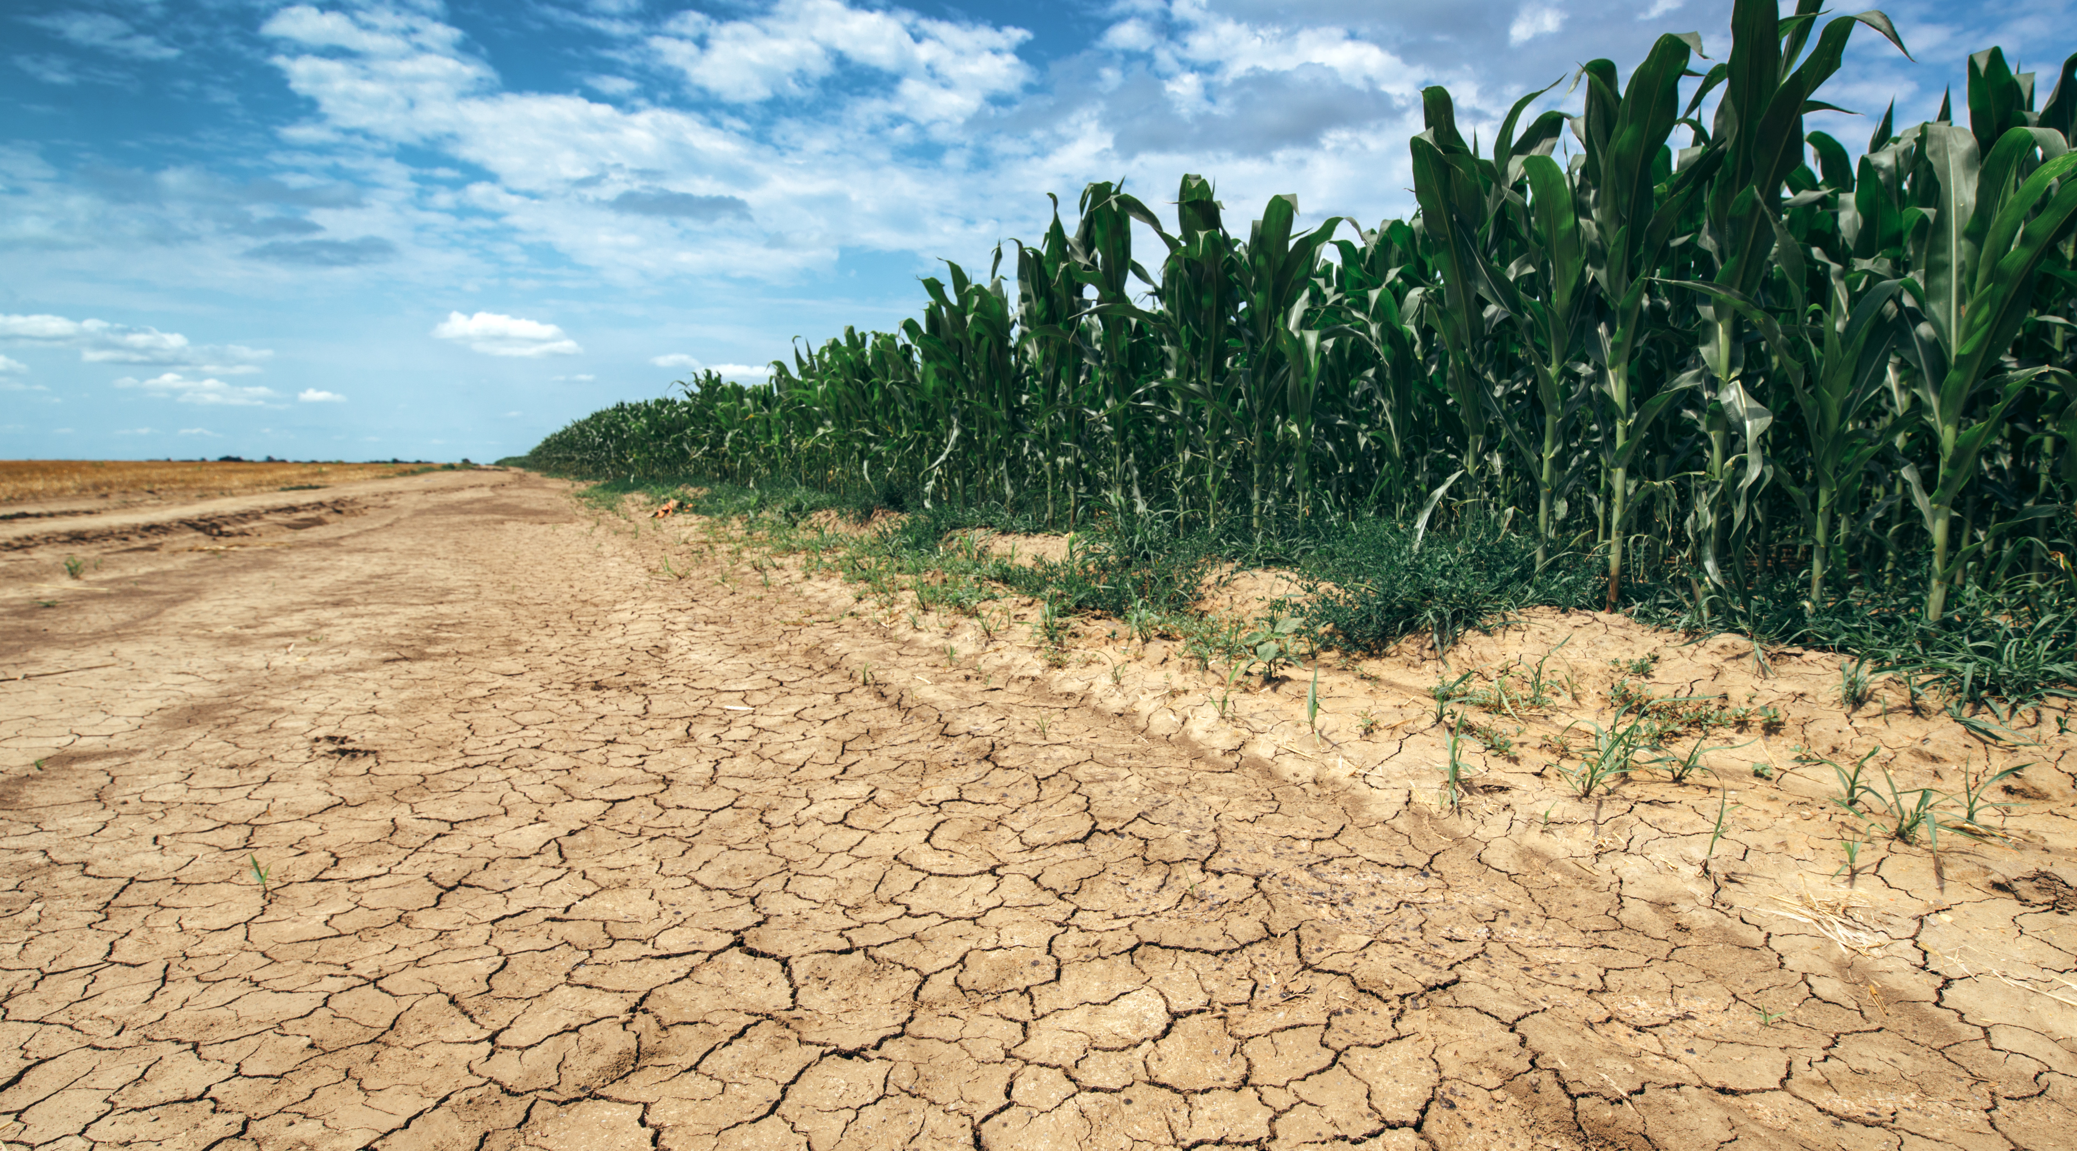

What Data Does the Model Learn From?
Photo: Adobe Stock
Photo: Adobe Stock
Photo: Adobe Stock
Natural & Human Geography
Climate & Agriculture
Societal Vulnerability
Terrain types by % of area, distance to natural resources, distance to capital and national border, exclusion of ethnic groups, etc.
PRIO-GRID v2.0 Derived from UNEP-WCMC, ISAM-HYDE, GPW, GEOEPR, EC JRC, CShapes, G-ECON, …
Drought, precipitation, length and status of growing season, quantity and area of main crops harvest, irrigation of main crops, etc.
MIRCA
MapSPAM
SPEI
Access to clean water and basic sanitation services, malnourishment, water use efficiency, renewable water resources, water stress, food prices & inflation, food insecurity, etc.
FAOSTAT & AQUASTAT
Notes:
Do we still have MIRCA MapsPam and SPEI data?

Slide 12

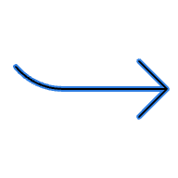


How Do We Collect and Transform Data?
1 | Data Ingestion & Harmonization Data retrieved from public data repositories through semi-automated process at monthly to annual intervals Cleaned and harmonized upon ingestion Human sanity checks Results stored in internal database for raw data
2 | Feature Selection Indicators of interest are specified into feature sets – one for each model Same indicator can be in several feature sets
3 | Feature Engineering Pre-processing of indicators in each feature set, in preparation for model training Spatial and temporal lags Techniques to fill in for missing data Decay functions … and more

Slide 13
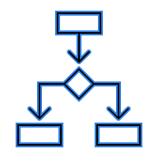

From Feature Sets to Sub-Model Forecasts
4 | Data Partitioning Before training the models, data is split into sequential partitions: one for model training, and one for model calibration Enable us to test the model on unseen data and tweak the model settings to improve performance
5 | Feature Set <> ML Algorithm Each feature set is combined with a Machine Learning algorithm Random forecasts, Gradient Boosting, Markov Models, Hurdle Models Coming soon: Neural Networks
6 | Sub-Model Forecasts Smaller models addressing the prediction problem from different angles; complete forecasts from each model

Slide 14
From Sub-Model to Ensemble Forecasts
7 | Ensemble Modeling No model captures everything – so, we use an ensemble to benefit from the “wisdom of the crowd” (diverse and skilled) Events out errors in sub-models and reduces risk of overfitting to training data Techniques Applied Country-level: a genetic algorithm assigns weights to the sub-model forecasts as they are combined into the final forecast Grid-level: simple average of sub-model predictions per step ahead Outputs are reconciled: country totals match sum of grid-level forecasts Optimized on Mean Squared Error (MSE) of predictions across all cases

Slide 15
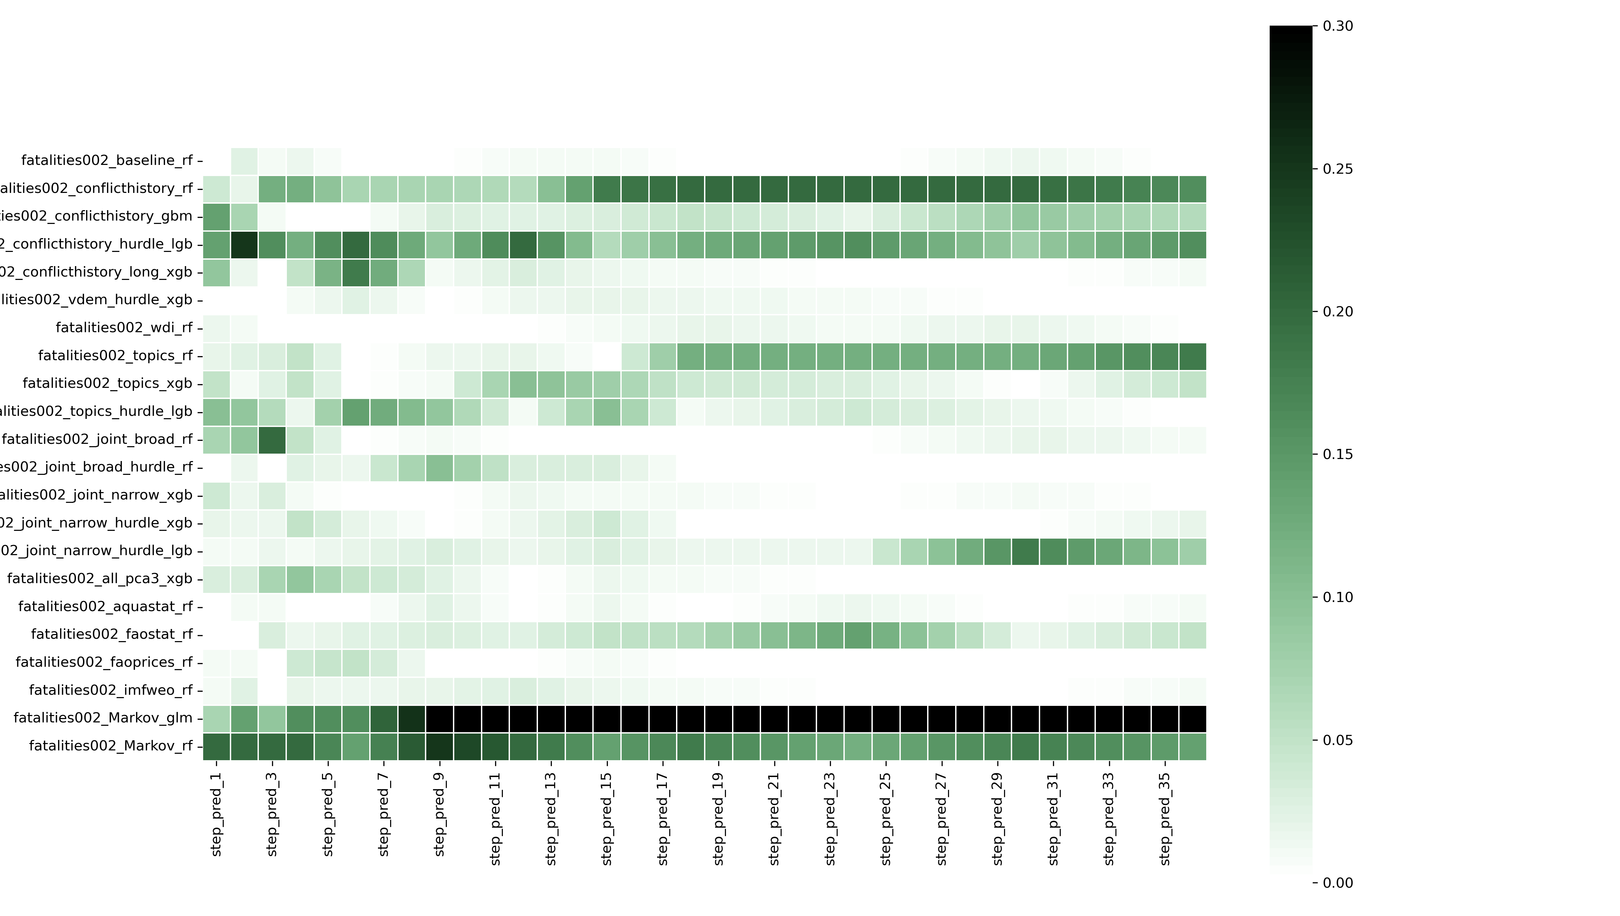
Model Weighting in the Country-Level Ensemble
Results from the genetic algorithm in September 2025: sub-model weights when forecasting 1-36 months ahead. Darker color = greater weight.

Slide 16
Model Performance

Slide 17
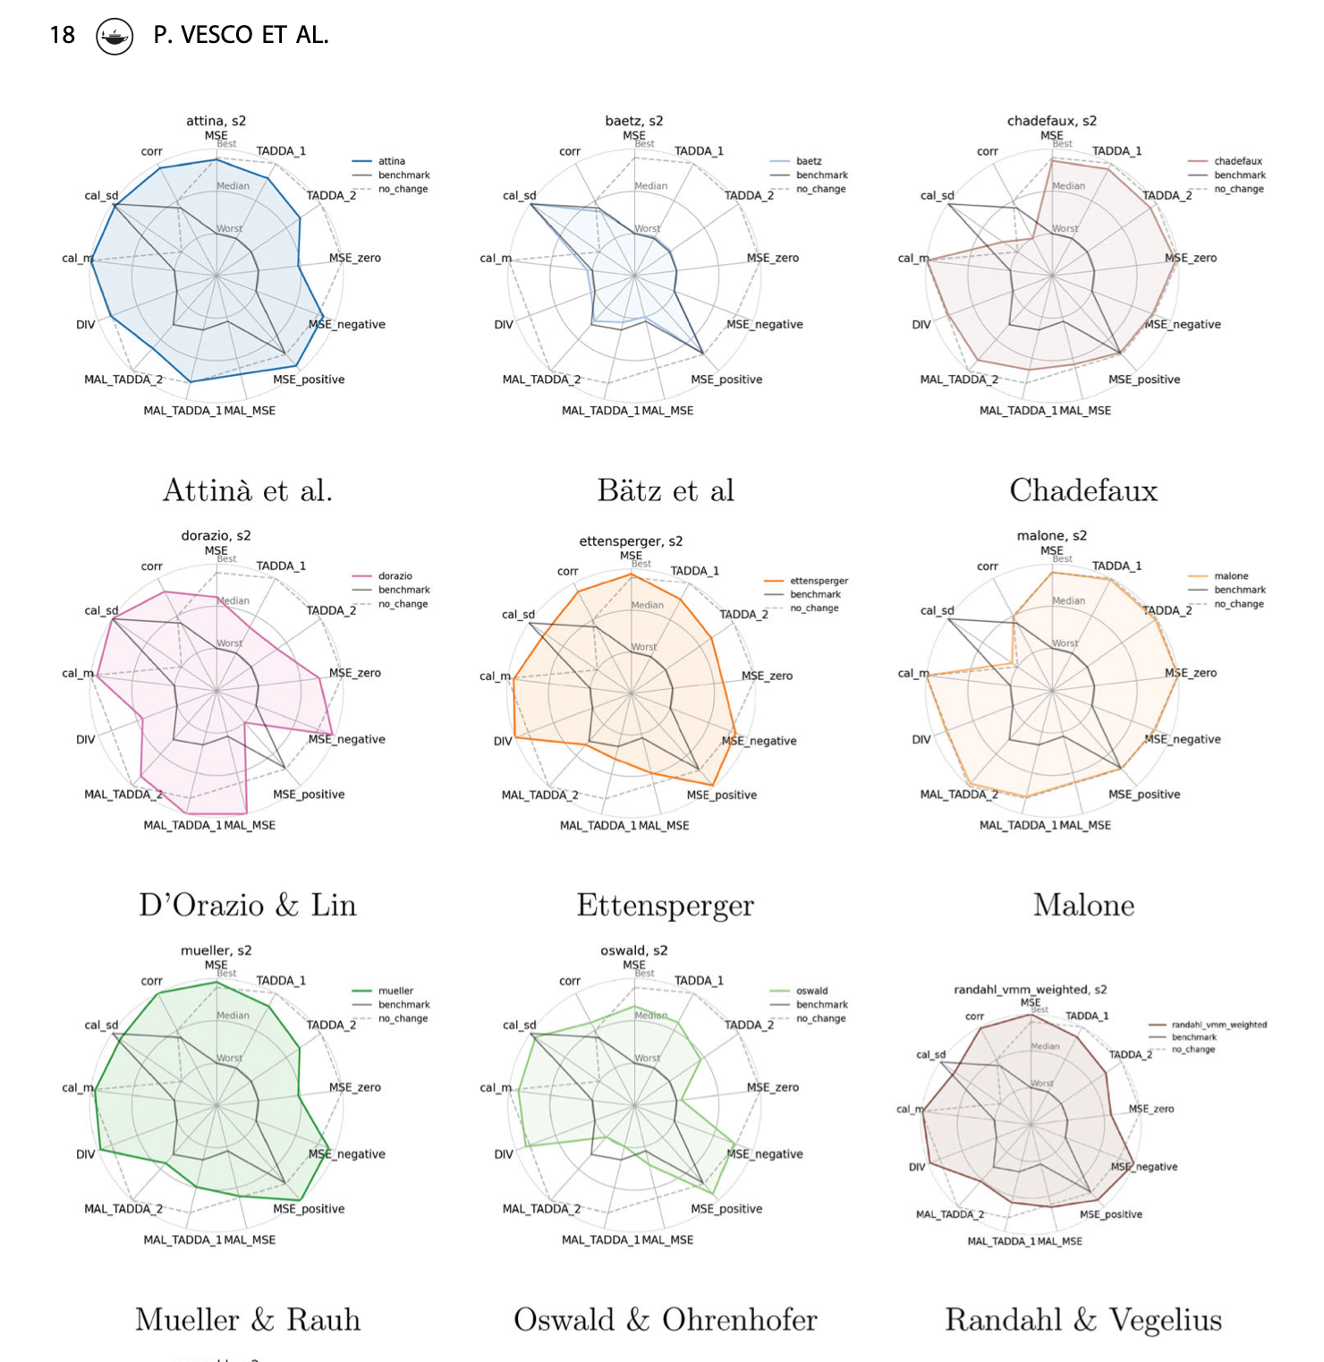
How Well Does the Model Perform?
What Constitutes a Good Prediction?
Models perform differently on different
evaluation metrics.
Results from competing teams in VIEWS’ first prediction challenge in 2020

Slide 18

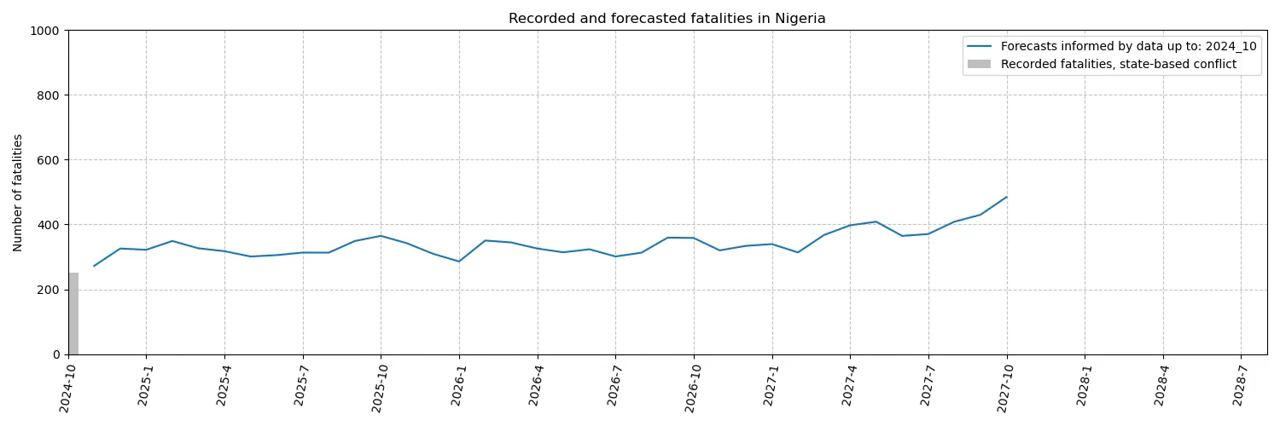
How Well Does the Model Perform?
The Model Is Good at Predicting Continuation
The model does quite well at predicting (de)escalation in existing conflict zones.
Read more: Forecasting Fatalities (Hegre et al. 2022)

Slide 19
How Well Does the Model Perform?
But, Onset of New Conflict is Challenging
Predicting onset of entirely new conflicts remains a major challenge across the conflict forecasting community.
Why?
Skewed conflict data
Time lags in conflict reports
Scarce availability of timely data on other triggers
Skepticism of prioritizing performance over interpretability

Slide 20
The Way Forward

Slide 21
How Can We Tackle the Prediction Problem?
GIS Data and Satellite Imagery
News-wire Text
Neural Networks
Actor Layer
Uncertainty Modeling
Notes:
Leveraging news-wire text, GIS data, and satellite imagery to pick up on dynamic developments
Introduction of more complex models, e.g. neutral networks
Actor-based forecasts to help us capture how different groups interact and contribute to conflict escalation
Modeling of uncertainty to allow us to capture not only the most likely outcome but also low-probability events that may have disastrous consequences – adding more nuance to the output.

Slide 22
The Pipeline: From Better Models to Better Systems
While model performance is crucial, but operational reliability is equally important for use in high-stakes domains.
Even strong models can be undermined by quiet failures: unnoticed data drift, corrupted inputs, or human error.
To maintain trustworthy, actionable forecasts, the system must catch issues before users do.
✅ A.C.T.S. principles will help ensure that forecasts are:
Auditable – Every step traceable and reproducible
Controllable – Versioned, modular components
Transparent – Clear outputs with continuous evaluation
Secure – Safeguards for data integrity through ‘fail fast, fail loud’ protocols
🚨 ‘Fail Fast, Fail Loud’ :
Drift detection on input/output data
Built-in alerts for missing or abnormal data
Automated checks before deployment
Forecasts flagged and stopped – not quietly degraded –when issues arise

Slide 23
Anticipatory Action

Slide 24
From Conflict to Conflict Impacts
While there is great value in predicting armed conflict, our prediction targets have proven difficult for practitioners to contextualize and integrate into AA workflows. So, what can we do?
1 | Communication & Collaboration Find a joint terminology and approach to discussing and analyzing conflict forecasts. Stakeholder dialogues Return periods?
2 | From Point Prediction to a Distribution of Possibilities Uncertainty modeling, allowing us to predict not only the most likely outcome but also risks of less likely but potentially catastrophic outcomes
3 | From Conflict Forecasts to Conflict Impacts Move from only predicting conflict to also predicting its adverse impacts: The number of people in need Impacts on, e.g., public health, economy, food insecurity

Slide 25
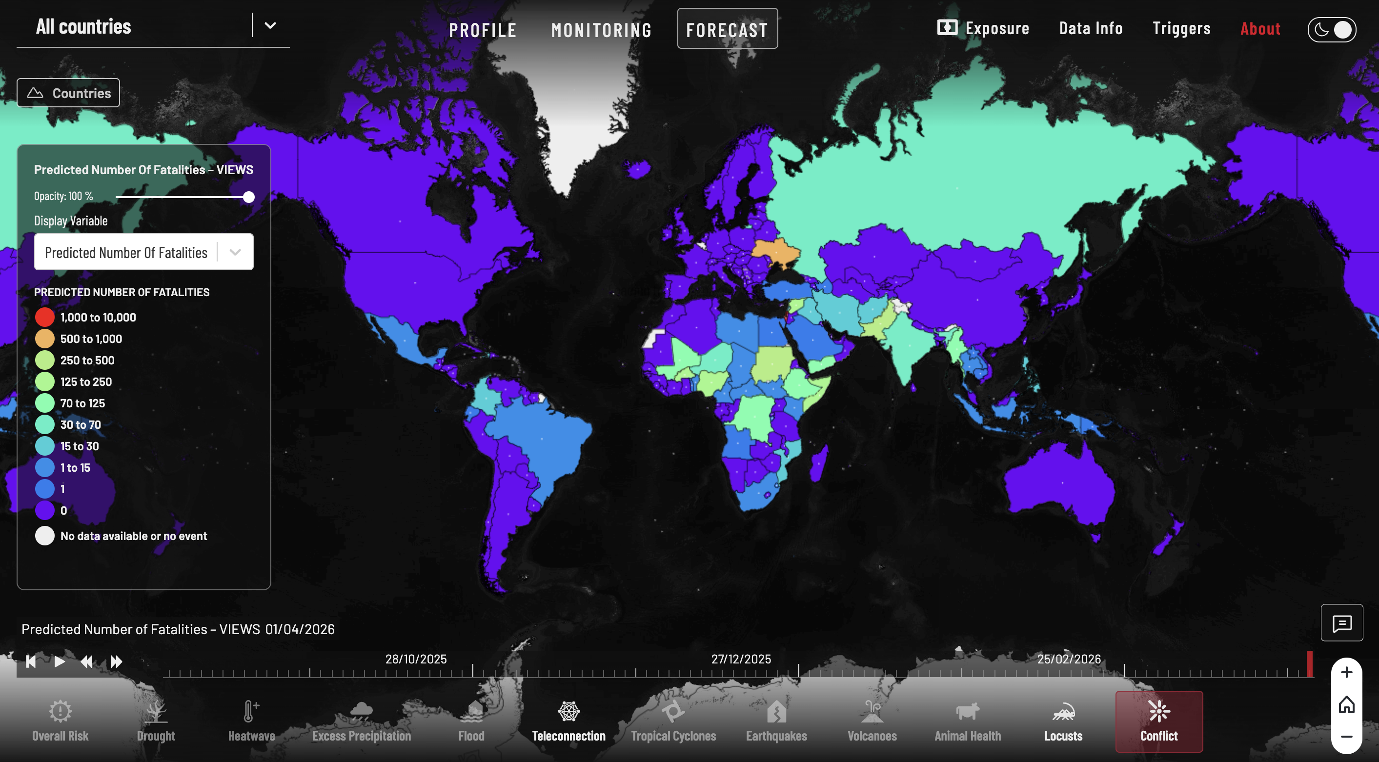
FAO’s Financing for Shock-Driven Food Crisis (FSFC) Facility
A global mechanism designed to prevent and rapidly respond to food crises by acting on early warnings before disasters escalate.
Parametric insurance that supports the release of anticipatory funding in response to emerging risks of food insecurity
Draws on a series of hazard indicators
VIEWS provides forecasts for the conflict component
Working on approach to assess predicted conflicts in terms of return periods
To be accompanied by uncertainty estimates
Prototype launched in July 2025 on the sidelines of the 44th Session of the FAO Ministerial Conference.
The FAO Risk Monitor, available at
https://riskmonitor.fao.org.
Read FAO announcement (FAO.org)

Slide 26
Collaboration Opportunities
Interested in piloting an AA solution with us? Get in touch!

Slide 27



Thank You!
Angelica Lindqvist-McGowan Head of Strategic Communications, VIEWS Department of Peace and Conflict Research, Uppsala University angelica.l.mcgowan@pcr.uu.se
Paola Vesco Senior Researcher
Peace Research Institute Oslo
paoves@prio.org
https://viewsforecasting.org/
info@viewsforecasting.org

