Slide 1


The Violence & Impacts Early-Warning System
DEMSCORE Data Manager Workshop
10 June 2025, University of Gothenburg

Slide 2
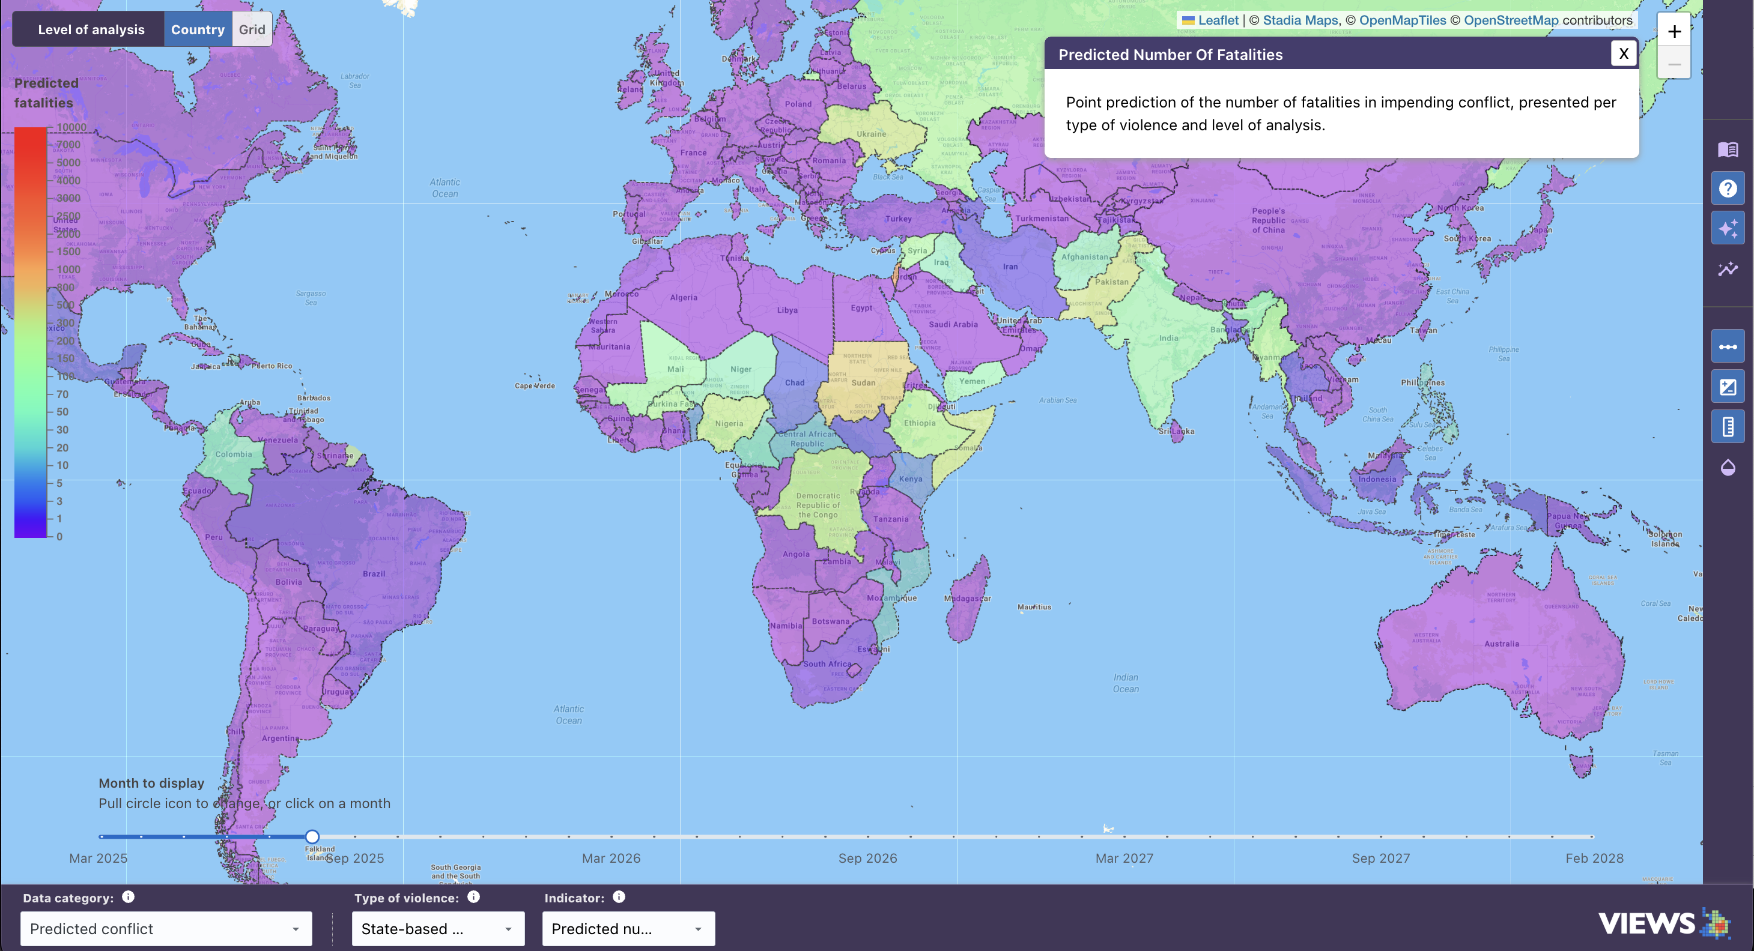
What is VIEWS?
The Violence & Impacts Early-Warning System (VIEWS) is a leading open-source platform for forecasting violent conflict. We provide scalable tools to support decision-makers in early and anticipatory action.
VIEWS is co-hosted by the Department of Peace and Conflict Research at Uppsala University and Peace Research Institute Oslo in Norway.
DEMSCORE Data Manager Workshop
10 June 2025

Slide 3



What Does the Model Learn From?
Photo: Adobe Stock
Photo: Adobe Stock
Photo: ALM
Conflict Event Data
Democracy Indices
Development Indicators
VIEWS aggregations of:
UCDP conflict data
ACLED conflict & protest data
Complemented by news topic analysis from ConflictForecast.org (forecasts).
Rule of law, accountability, civil liberties, executive corruption, women political participation, civil society participation, etc.
V-Dem
GDP per capita, infant mortality rate, life expectancy, school enrollment, population, malnourishment, net migration, etc.
WDI
DEMSCORE Data Manager Workshop
10 June 2025

Slide 4



What Does the Model Learn From?
Photo: Adobe Stock
Photo: Adobe Stock
Photo: Adobe Stock
Human Geography
Climate & Agriculture
Societal Vulnerability
Terrain types by % of area, distance to natural resources, distance to capital and national border, exclusion of ethnic groups, etc.
PRIO-GRID v2.0 Derived from UNEP-WCMC, ISAM-HYDE, GPW, GEOEPR, EC JRC, CShapes, G-ECON, etc.
Drought, precipitation, length and status of growing season, quantity and area of main crops harvest, irrigation of main crops, etc.
MIRCA
MapSPAM
SPEI
Access to clean water and basic sanitation services, malnourishment, water use efficiency, renewable water resources, water stress, food prices & inflation, food insecurity, etc.
FAOSTAT & AQUASTAT
DEMSCORE Data Manager Workshop
10 June 2025

Slide 5
Data Requirements
Reputability and Transparency:
Publicly available
Credible institutions
Complete and transparent documentation
Granular Coverage In Time & Space:
Preferably monthly temporal units
Global coverage at country level
Grid-level (0.5°) coverage for at least Africa & Middle East level, preferably global
Historic Data:
Preferably dating back to 1990
Sustained Maintenance and Update Frequency:
Timely updates
Structured & standardized
Well-maintained
Ideally: backed by institutional commitment
DEMSCORE Data Manager Workshop
10 June 2025

Slide 6
How Do We Collect and Transform Data?
Data Ingestion & Harmonization
Feature Engineering
Spatial and temporal lags
Predictor Datasets
Large panel datasets
Fetched from public data repositories and/or APIs
Cleaned and harmonized
Result stored in internal database for raw data
Filling in for missing data
Decay functions
… and more
Semi-automated, standardized ingestion at monthly to annual intervals
Each comprised by the features of interest for a given ML model
Stored in reproducible ‘querysets’ – separate from the raw data
DEMSCORE Data Manager Workshop
10 June 2025

Slide 7
From Input Data to Sub-Model Forecasts
Queryset
ML Algorithm
Each queryset is combined with an ML algorithm
Sub-Model Forecast
Complete forecast dataset from the given model
For each model, a queryset is specified detailing the features to include in its training dataset
Querysets can overlap; the same features can be used in multiple models
Random forests, Gradient Boosting, Markov Models, Hurdle Models
DEMSCORE Data Manager Workshop
10 June 2025

Slide 8





From Sub-Models to Ensemble Forecasts
No single model captures everything – so, we use an ensemble
Like the “wisdom of the crowd” – best when diverse and skilled
Evens out errors in sub-models and reduces risk of overfitting to training data
Ensembling Techniques
Country level: weighted combination using a genetic algorithm
Grid level: simple average of model outputs
Outputs are reconciled so country totals match summed grid predictions
Input Data
Modeling
Sub-Model Forecasts
Weighting
Input Data
Modeling
Sub-Model Forecasts
Weighting
Ensemble Forecasts
Weighting
Input Data
Modeling
Sub-Model Forecasts
DEMSCORE Data Manager Workshop
10 June 2025

Slide 9
The Challenges – Input Data
Data timeliness & limited coverage
Missing data
Geographic imprecision of events data
Revalidation pressure from key users
DEMSCORE Data Manager Workshop
10 June 2025

Slide 10
The Challenges – Modeling
Forecasting rare events: sparsity, imbalanced data
Lagged data lagged forecasts
Uncertainty
Trade-off in model design: Predictive performance vs interpretability
Sustaining operational relevance over time
And – of course – funding: Most funders seek new and shiny, not “boring” maintenance and upgrades of existing infrastructure.
Kernel density plots for all country-months with non-zero fatality counts over 1990-2020. Source: UCDP GED 21.1.
DEMSCORE Data Manager Workshop
10 June 2025

Slide 11
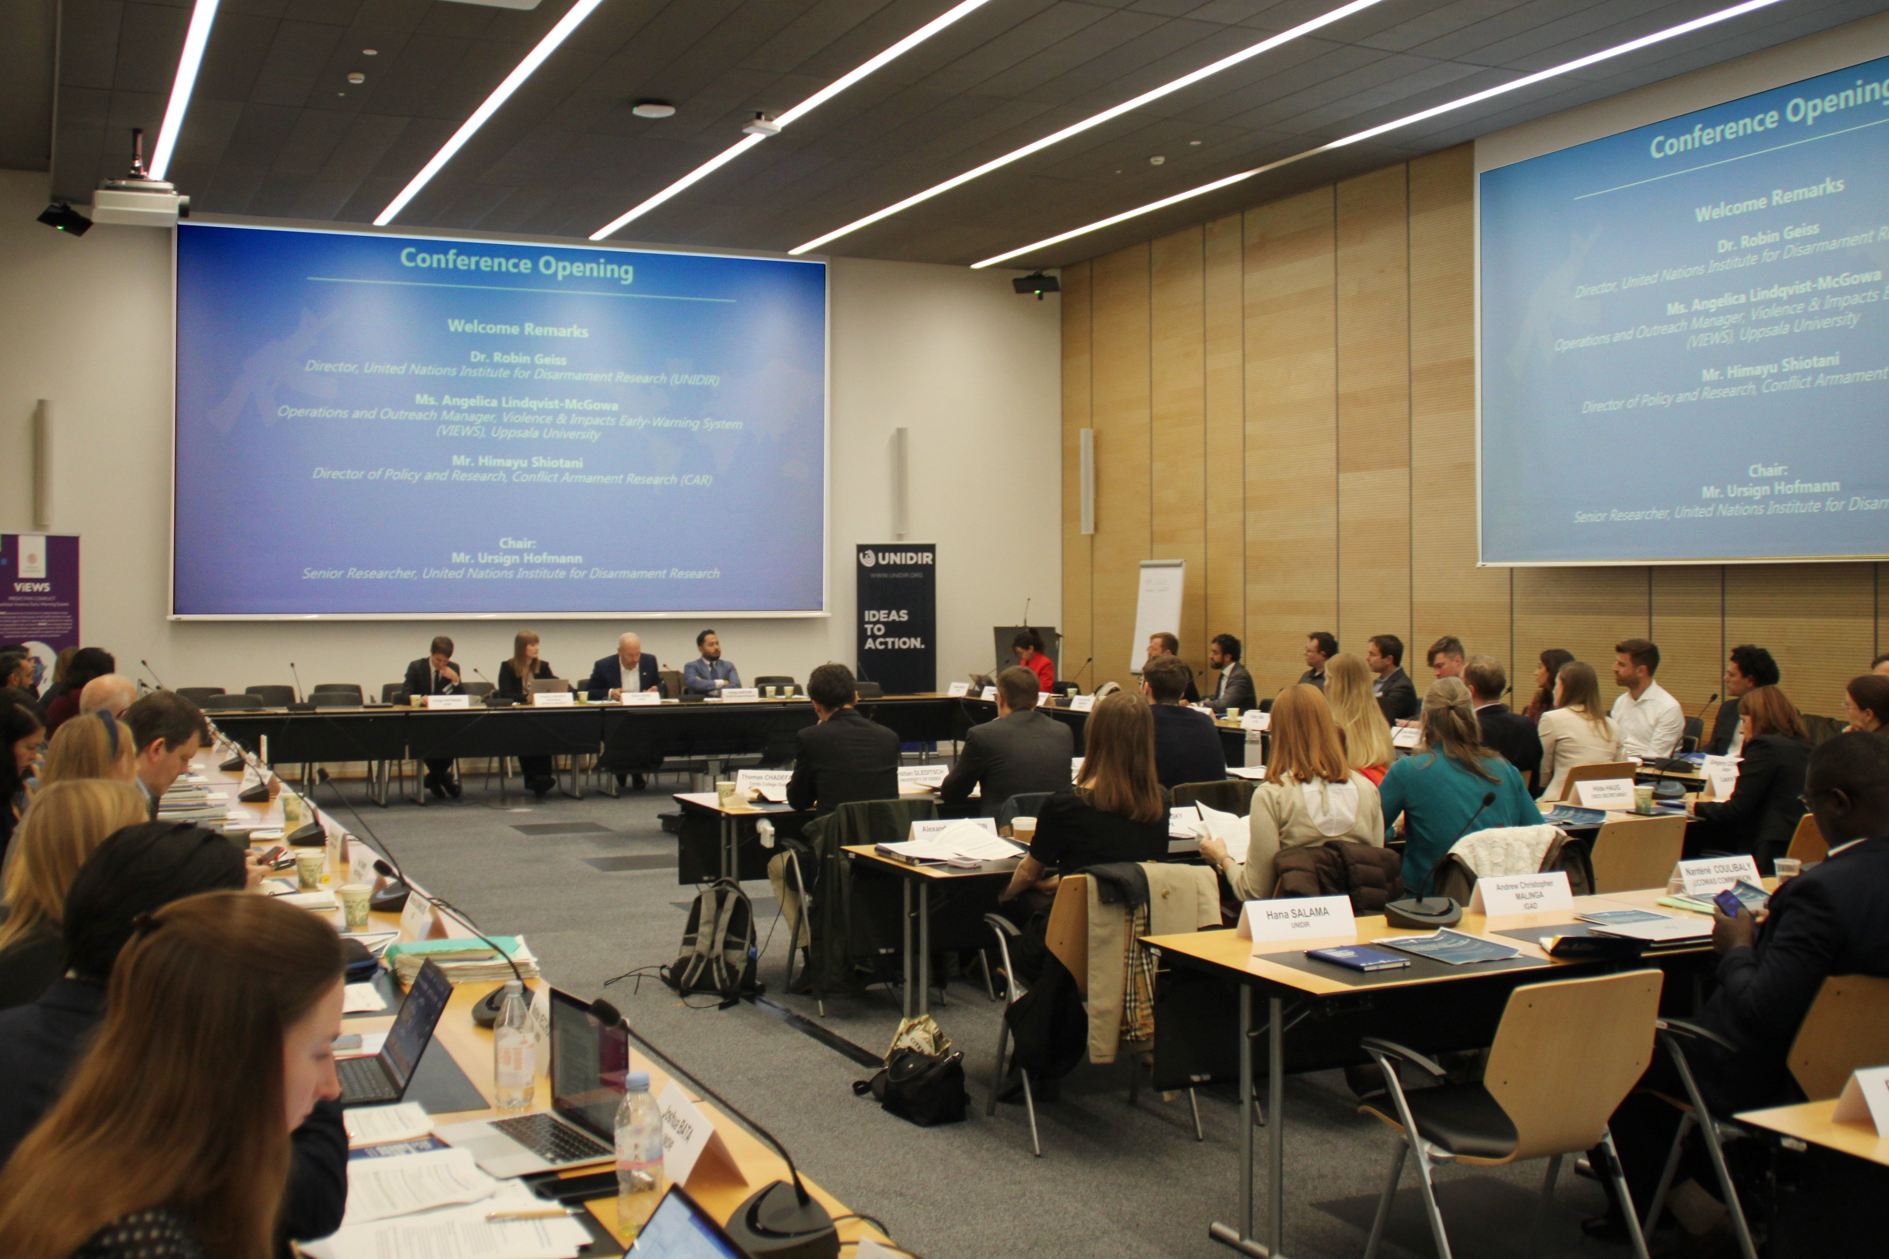
The Challenges – Communication
Semantics
Translating complex technology to non-technical audiences – finding the right level of detail without risks of misuse
Correlation is not causation
Drivers of forecasts ≠ drivers of conflict
A complement to existing knowledge structures – not a replacement
Opening of the multistakeholder conference “Building bridges and incubating ideas for stronger conflict prevention: Harnessing arms and ammunition flows data for early warning” in Geneva 2024, co-hosted by UNIDIR, VIEWS & CAR.
DEMSCORE Data Manager Workshop
10 June 2025

Slide 12
Opportunities for Collaboration
What We Can Offer:
Expertise in conflict forecasting, the impacts of armed conflict, and EWEA
Monthly conflict forecasts
Open data & open-source code
(Soon) MLOps forecasting pipeline
Broad network of researchers, policymakers and practitioners
Areas for Collaboration:
Forecasting with uncertainty
Conflict impact modeling
Shared methods, evaluation standards
Responsible AI governance
Moving from EW to EA
Outreach
DEMSCORE Data Manager Workshop
10 June 2025

Slide 13


Thank You For Listening!
Angelica Lindqvist-McGowan Operations & Outreach Manager VIEWS and Societies at Risk Department of Peace and Conflict Research, Uppsala University angelica.l.mcgowan@pcr.uu.se
https://viewsforecasting.org/
info@viewsforecasting.org
DEMSCORE Data Manager Workshop
10 June 2025

